Slide 1

Title : Online Restaurant
Group Members:
Muhammad Junaid Dhillon
Hammad Ijaz
Syed Muhammad Taha
Shahmeer Khan
Soban Chatta
Muhammad Qasim
Food Junction

Slide 2


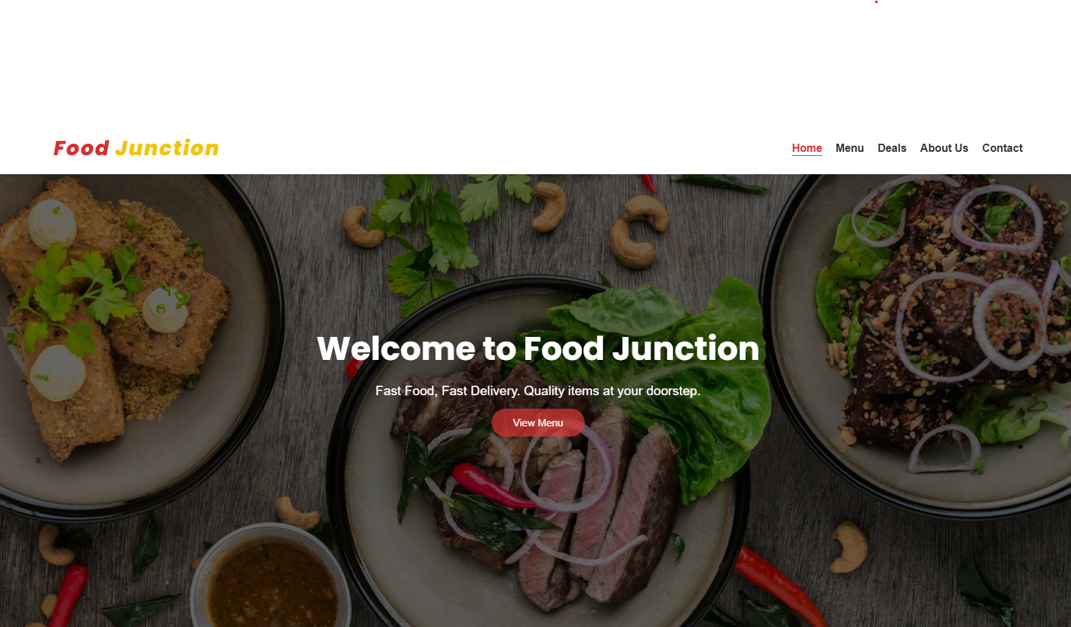
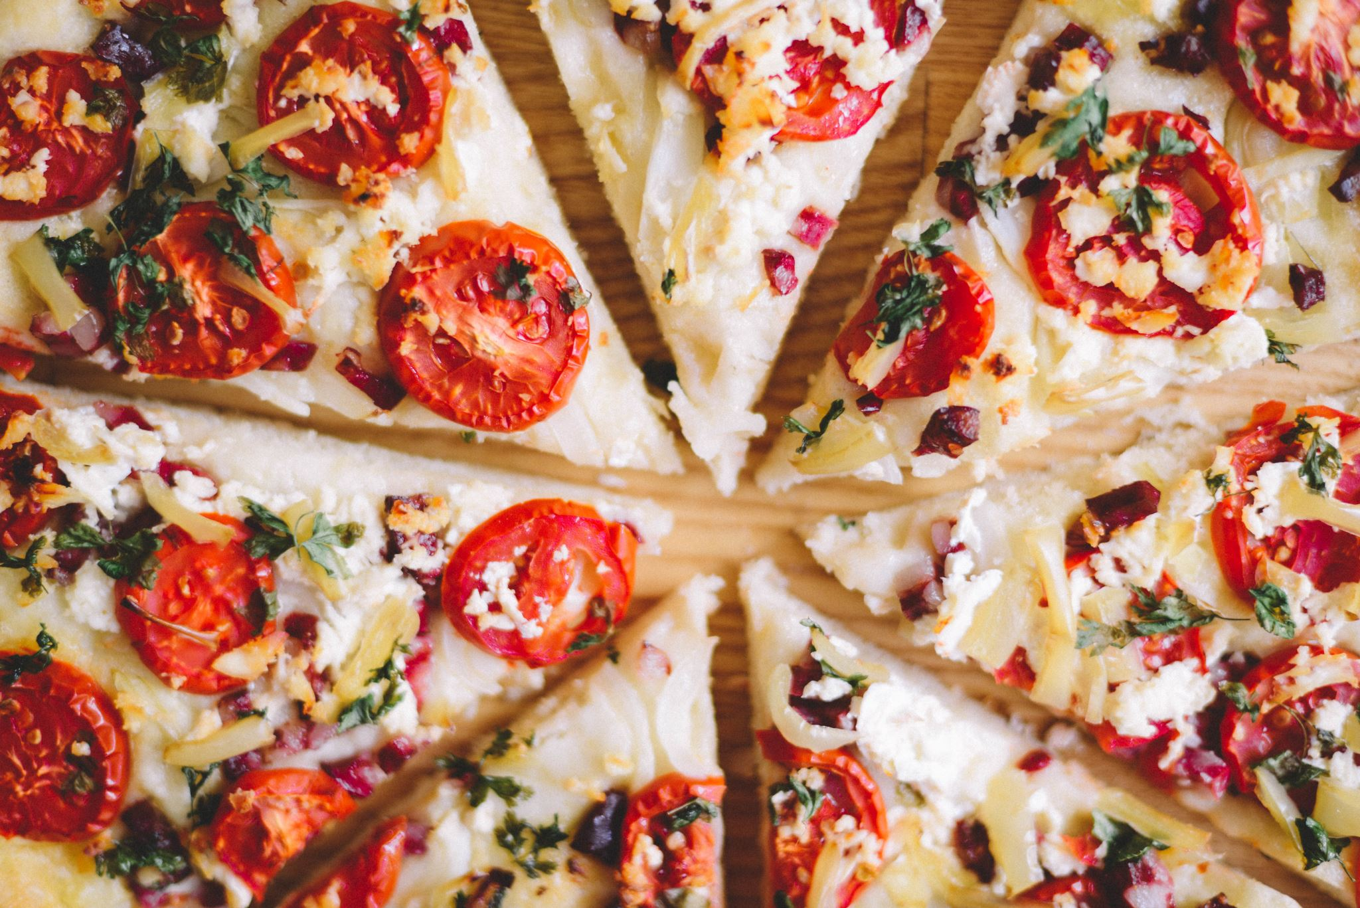
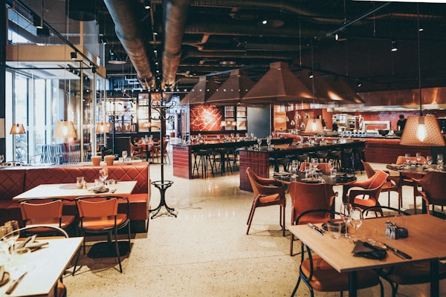
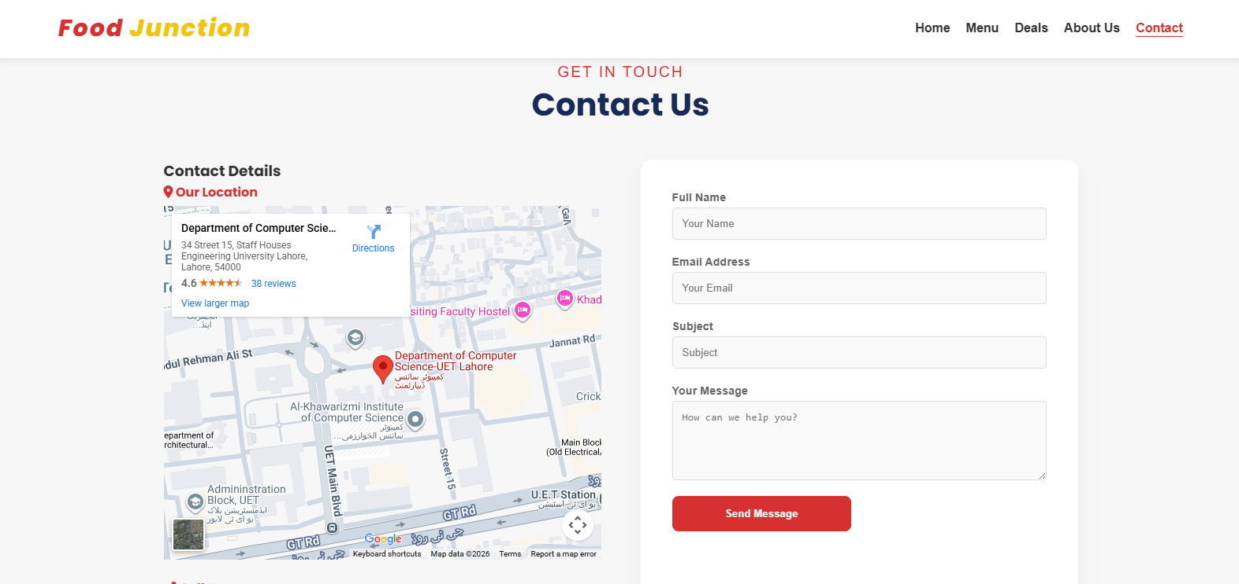
Title: Online Restaurant
Objectives
Group Members:
Muhammad Junaid Dhillon
Hammad Ijaz
Syed Muhammad Taha
Shahmeer Khan
Soban Chatta
Muhammad Qasim
Present Food Junction website
Showcase multi-page navigation
Demonstrate data analysis using Excel
Share live demo & GitHub link
Food Junction

Slide 3


Objectives:
Present Food Junction website
Showcase multi-page navigation
Demonstrate data analysis using Excel
Share live demo & GitHub link
Food Junction
HOME
At homepage suggestions, food gallery and required order details are present

Slide 4

HOME
At homepage suggestions, food gallery and required order details are present

Slide 5
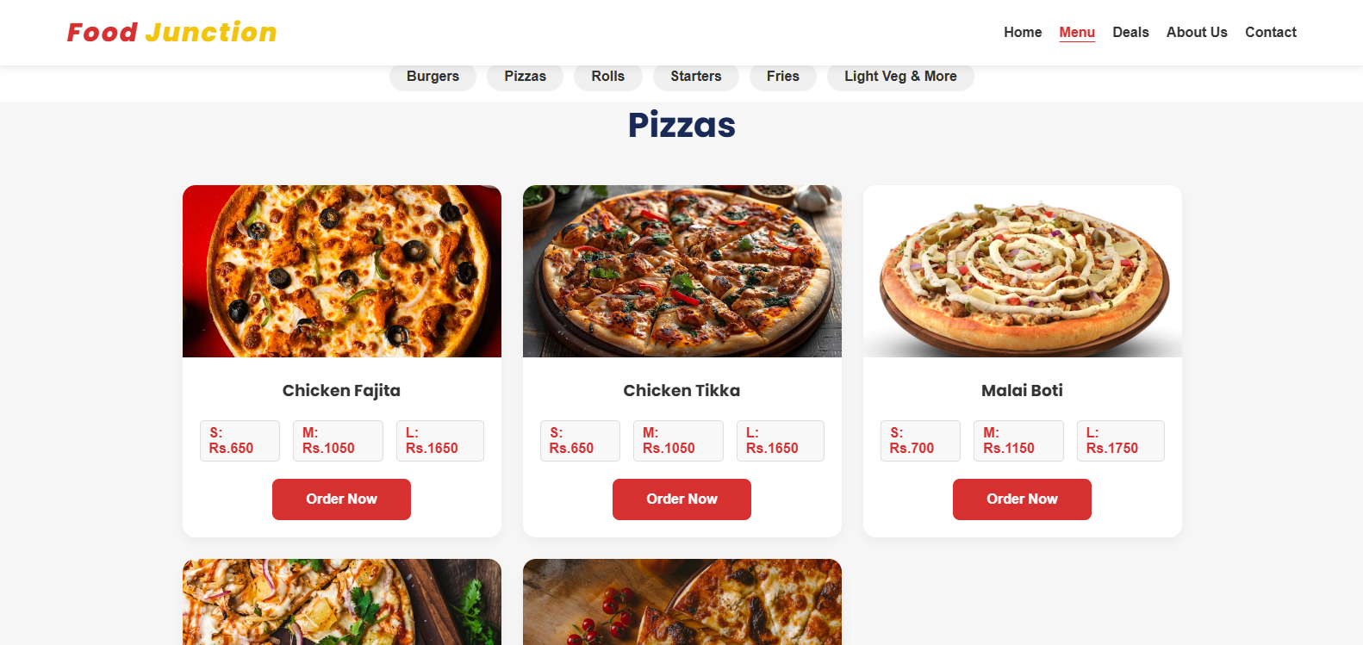
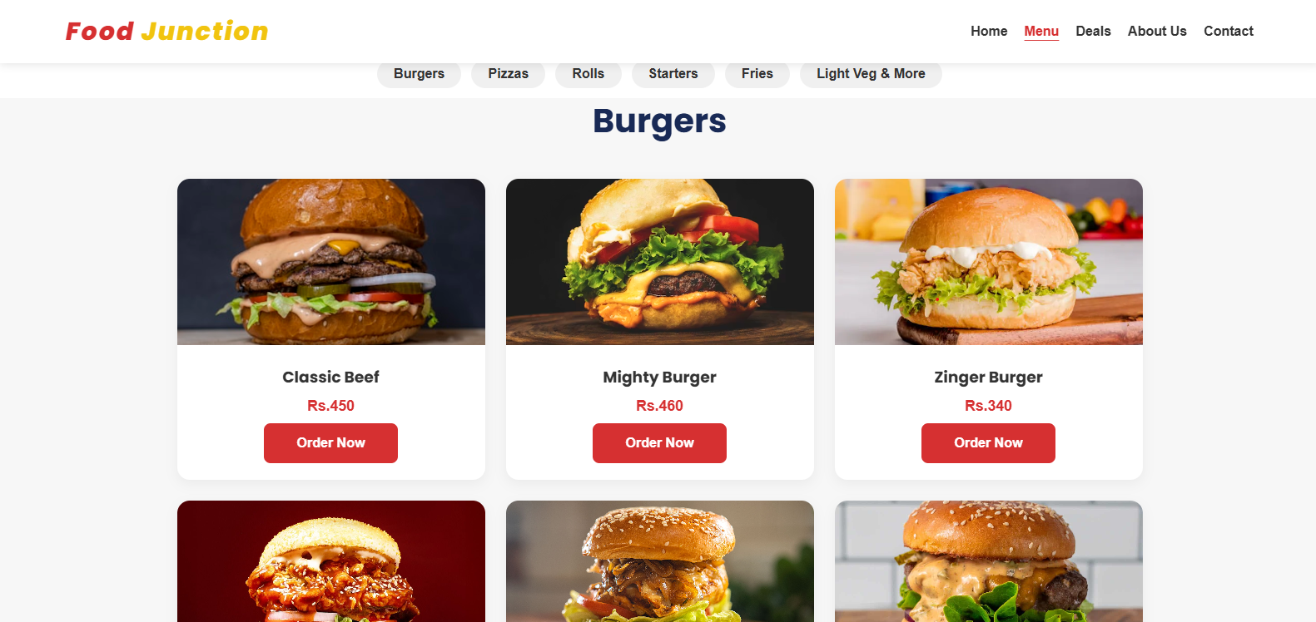
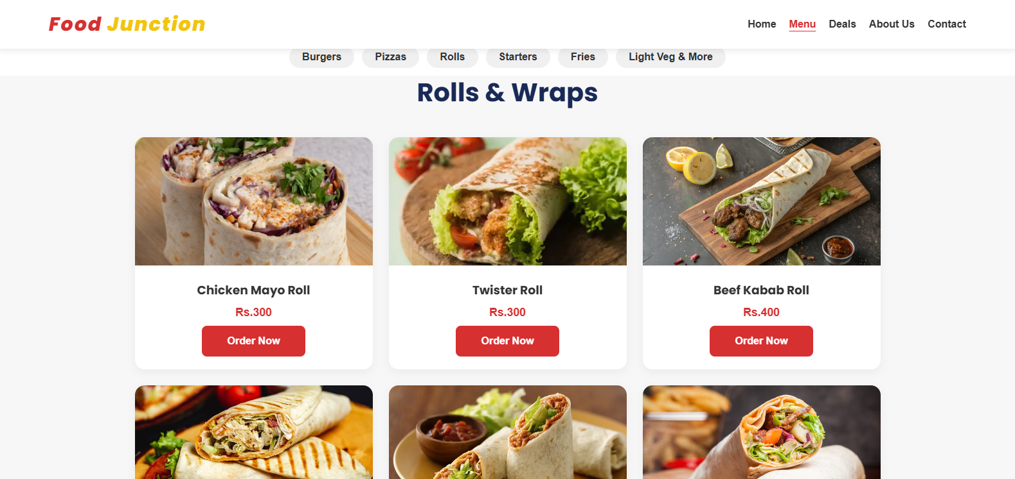
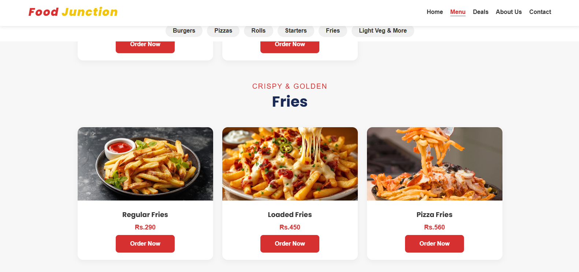
HOME
At homepage suggestions, food gallery and required order details are present

Slide 6
MENU
At From starters to desserts, our menu has something for everyone

Slide 7
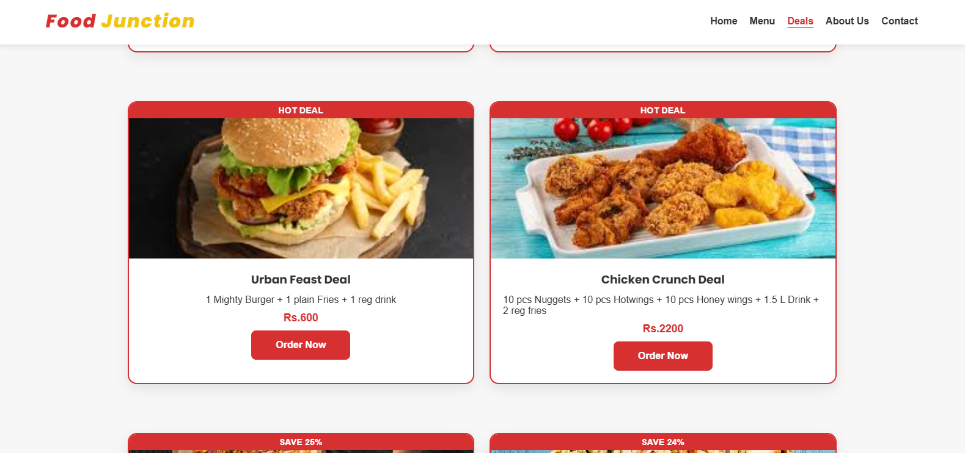
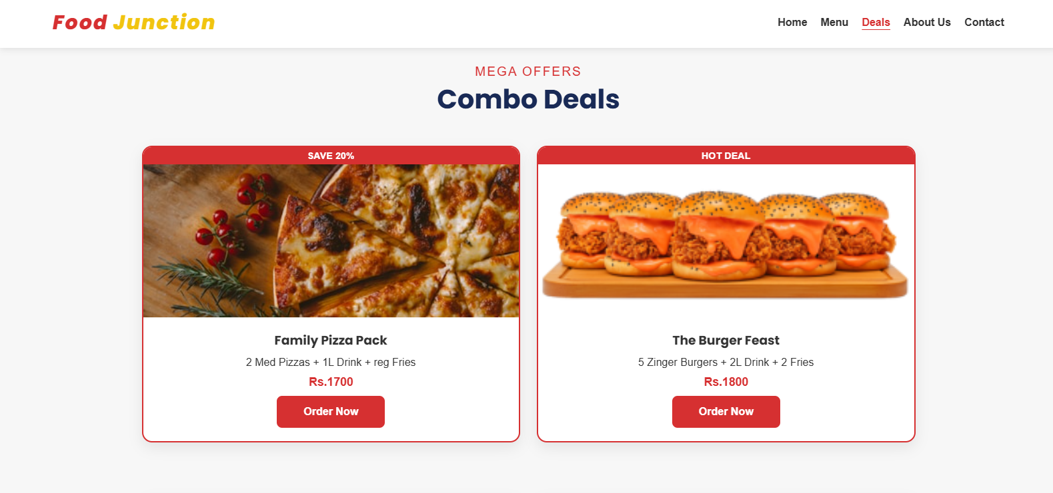
MENU
At From starters to desserts, our menu has something for everyone

Slide 8
Upto 30
DEALS
Take a look at our mouthwatering deals crafted just for you!

Slide 9
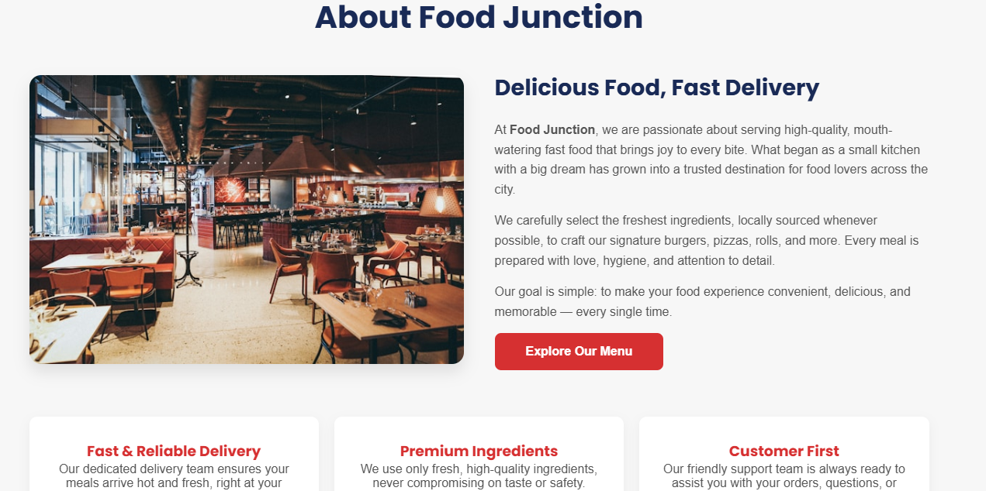
DEALS
Take a look at our mouthwatering deals crafted just for you!
DEALS
Deals include all the current deals on the restaurant

Slide 10
ABOUT US
This section gives you an insight into Food Junction and Customer reviews form, where visitors share feedback and you can leave yours too!

Slide 11
ABOUT US
This section gives you an insight into Food Junction and Customer reviews form, where visitors share feedback and you can leave yours too!

Slide 12

CONTACT US
Contact us includes location, phone numbers , emails and contact form for reaching our restaurant

Slide 13
CONTACT US
Contact us includes location, phone numbers and emails for reaching our restaurant

Slide 14
Key Data & Insights
01
Total revenue reached is Rs. 86,390
02
Average order by each customer is Rs. 2880
03
Combo Deals generated the highest revenue
04
Rolls and Wraps has the highest sales volume

Slide 15
Key Data & Insights
01
Total revenue reached is Rs. 86,390
02
Average order by each customer is Rs. 2880
03
Combo Deals generated the highest revenue
04
Rolls and Wraps has the highest sales volume

Slide 16
DEMO LINK
https://tahashah123.github.io/online-resturant/
GITHUB URL
https://github.com/tahashah123/online-resturant.git
Food Junction

Slide 17
DEMO LINK
REFLECTION AND NEXT STEPS
https://tahashah123.github.io/online-resturant/
REFLECTION
Learned multi-page website design
Used Excel for data-driven decisions
GITHUB URL
NEXT STEPS
Features expansion and improvements
Technical improvements
Integrating data and responsiveness
https://github.com/tahashah123/online-resturant.git
Food Junction

Slide 18
THANKS
We appreciate your time and attention!
Food Junction

